Slide 1
Medical image denoising using autoencoders
Presented By- Submitted to-
Ashish (21112017) Dr. D.n roy sir
Karan (21112036)

Slide 2
Problem statement
In medical images like MRI , CT Scan and X-Ray when original images are put in the paper, the quality degrades, due to which the accuracy of the decision model degrades. These images are susceptible to noise.
Image denoising is required to suppress noise from noise-contaminated images and hence, is an important preprocessing step in image analysis

Slide 3
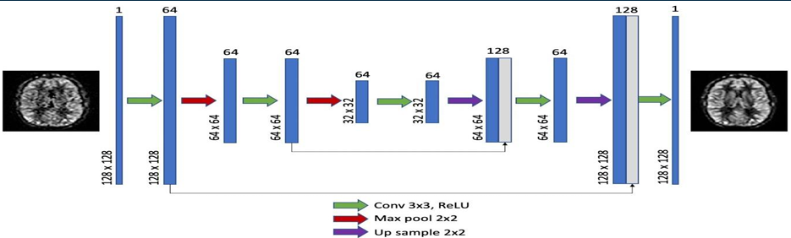
Image Denoising
Image denoising refers to the process of reducing or removing unwanted noise from an image.
The presence of noise can degrade the quality of an image, making it difficult to interpret or analyze accurately.
Image denoising techniques aim to enhance the clarity and quality of images by reducing or eliminating noise while preserving important image details

Slide 4
Do we really need denoising for X-ray or Ct scan images
Yes, denoising is often important for X-ray and CT scan images, especially when it comes to improving the quality of diagnostic results
Removing noise can help radiologists detect smaller abnormalities (e.g., tumors, fractures, etc.) that might otherwise be overlooked due to image degradation.
In CT scans, lower radiation doses can result in more noisy images. Denoising allows for the use of reduced radiation levels while maintaining image quality.

Slide 5
Medical imaging modalities like X-rays and CT scans are susceptible to noise due to factors like low radiation doses, detector limitations, or patient movement during imaging.
Noise can be seen as grainy or pixelated areas in the image, which can obscure important features, such as subtle lesions or fractures.
Types of Noises in Medical Imaging-
1. Gausian Noise
2. Salt and Peper Noise
3. Motion Noise

Slide 6
Ways of Denoising Images
1. Spatial Filtering Techniques
These methods apply filters to the image, either locally (neighborhood-based) or globally, to smooth out noise.
2. Transform Domain Techniques
Transform-based methods operate on an image after it has been transformed into another domain, such as the frequency domain, to reduce noise.

Slide 7
3. Machine Learning-Based Techniques
Modern denoising methods often use machine learning to learn the noise patterns and remove noise without losing important details.

Slide 8
Autoencoders
Autoencoder is an unsupervised artificial neural network that is trained to copy its input to output
Autoencoder first encodes the image into a lower-dimensional representation, then decodes the representation back to the image
The goal of an autoencoder is to minimize the difference between the input and the reconstructed output, forcing the network to capture the most important features or patterns in the data

Slide 9
Autoencoders are only able to compress data similar to what they have been trained on. They are also lossy in nature which means that the output will be degraded compared to the original input.

Slide 10
Architecture of Autoencoders
There are mainly 3 parts in autoencoders:
1. Encoder: In this part of the architecture the model compresses the input data to represent the compressed data in a reduced dimension
2. Code: Also known as Bottleneck this part of the architecture represents the compressed data that is going to be fed to the decoder
3. Decoder: This part reconstructs the encoded data as close to the input data as possible. The output from the decoder is a lossy reconstruction of the original data.

Slide 11
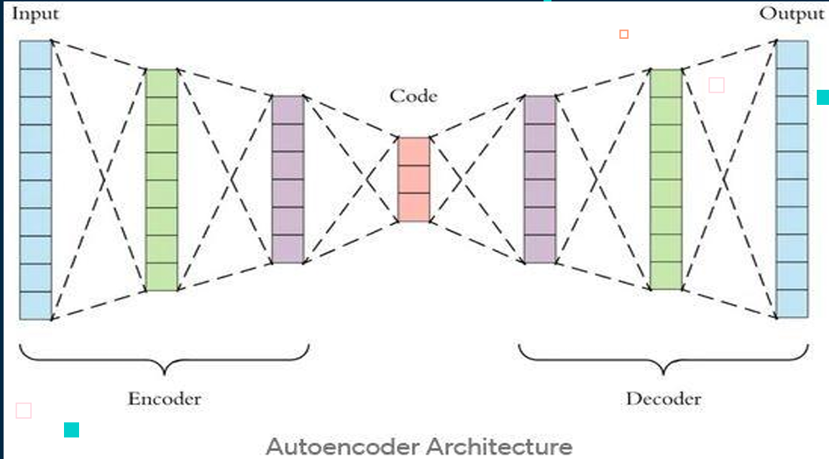

Slide 12
Hyperparameters of Autoencoders
There are mainly 4 parameters that we need to set before training the autoencoder
Code size: This represents the number of nodes in the middle layer. The smaller the code size more the compression
Number of Layers: We can make layers in encoder and decoder as deep as possible

Slide 13
The number of nodes per layer: Usually the number of nodes per layer decreases with each subsequent layer of an encoder and then starts increasing again with each subsequent layer of the decoder. The decoder is symmetric to the structure of the encoder Loss function: The popular choices here are mean squared error(MSE) or binary cross-entropy. If the input values are in the range [0,1] then binary cross-entropy is favored as compared to MSE. Otherwise, we just use MSE.

Slide 14
Training Dataset
The datasets used for this project were sourced from Kaggle. Each dataset was preprocessed by resizing the images to a uniform resolution of 128×128 pixels and converting them to grayscale where necessary. As the denoising task is unsupervised, all labels were removed during preprocessing.

Slide 15
Preprocess Image:
Before training, all datasets undergo a consistent preprocessing pipeline that includes the following steps:
Resizing: All images are resized to a fixed resolution of 128×128 pixels.
Padding: Applied when there is a significant variation in aspect ratios to maintain spatial consistency.
Normalization: Pixel values are scaled to the [0, 1] range to facilitate faster and more stable training.

Slide 16
Tensor Conversion: Processed images are converted into PyTorch tensors for model compatibility.
Noise Addition:
To simulate realistic noise, Gaussian noise is synthetically added:
Mean: 0.0
Standard deviation: 1.5
This enables consistent model training and benchmarking.
Defining Autoencoder:
Encoder – Compresses the image:
Conv2D(64): Applies 64 filters (3×3) to extract low-level features (edges, textures, etc.).
MaxPooling2D((2, 2)): Down samples the feature maps by 2×, reducing spatial dimensions and keeping important features.

Slide 17
Conv2D(128): Learns more complex features with 128 filters.
MaxPooling2D((2, 2)): Further down samples to compress the representation.
Decoder – Reconstructs the image:
Conv2D(128): Starts decoding with 128 filters.
UpSampling2D((2, 2)): Doubles the spatial size (opposite of pooling).
Conv2D(64): Refines features using 64 filters.
UpSampling2D((2, 2)): Restores the original image size.
Conv2D(1): Produces the final single-channel output with sigmoid (since pixel values range from 0 to 1).

Slide 18
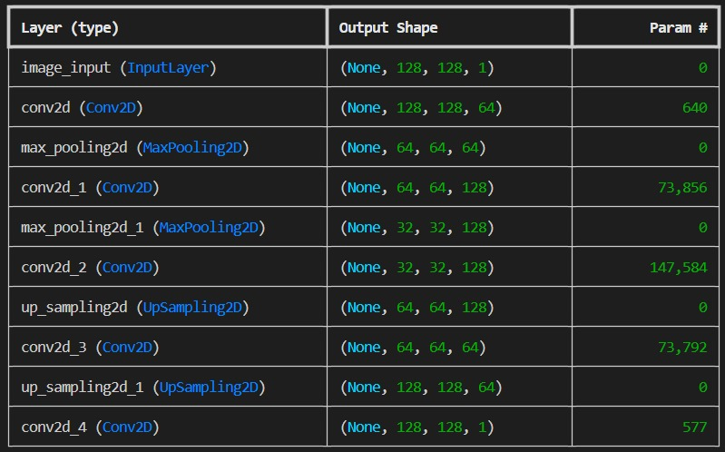

Slide 19
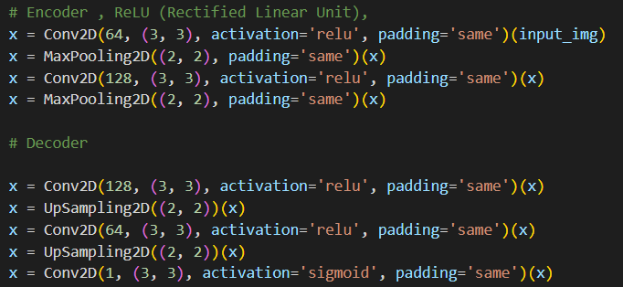

Slide 20
Results

Slide 21
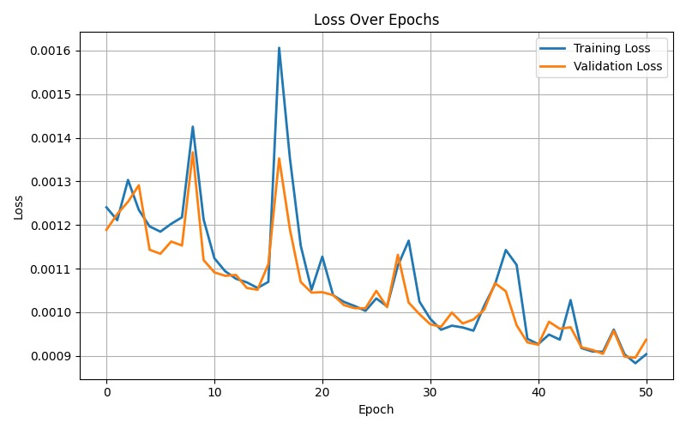
The plot shows training and validation loss over 50 epochs. Initially, both losses fluctuate but decrease steadily, indicating effective learning and noise reduction. The close alignment of the training and validation losses suggests the model is generalizing well without overfitting. By the end, both losses stabilize at 0.0009, reflecting high-quality reconstruction.

Slide 22
Interpretation : X-axis (Epochs): Number of complete passes through the training dataset (0–50).
Y-axis (Loss): Reconstruction error; lower values indicate better performance . Blue Line – Training Loss: Loss on the training dataset .
Orange Line – Validation Loss: Loss on the validation dataset (unseen during training).
Observations : Both training and validation losses initially fluctuate slightly as the model begins to learn . Losses then decrease steadily, reflecting effective learning and noise reduction . The close alignment of training and validation losses throughout training suggests good generalization with minimal overfitting . By 50 epochs, both losses stabilize around 0.0009, indicating high-quality reconstruction by the autoencoder.

Slide 23
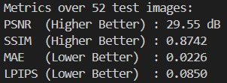
Metrics over 52 test images
PSNR (29.55 dB): Indicates good noise removal and clear image reconstruction.
SSIM (0.8742): Shows that the model preserved important structural details well.
MAE (0.0226): Reflects very small average pixel differences between original and denoised images.
LPIPS (0.0850): Suggests that the denoised images are perceptually very close to the original ones.

Slide 24
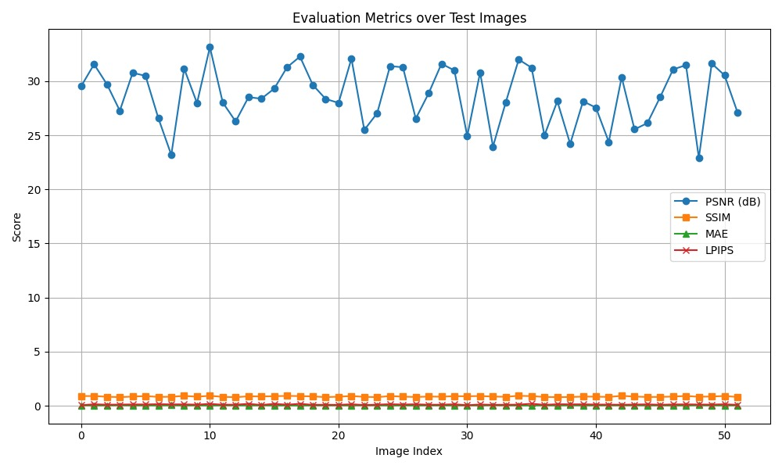

Slide 25
Evaluation Metrics Interpretation :-
This graph presents the performance of the autoencoder across 50 test images using four metrics :
PSNR (dB): Indicates reconstruction quality. Values between 25–33 dB reflect good noise removal and image fidelity .
SSIM: Measures structural similarity. Scores close to 1 indicate strong structural preservation .
MAE: Represents average pixel-wise error. Low values show minimal difference from original images.

Slide 26
LPIPS: Evaluates perceptual similarity. Low scores imply high perceptual quality .
Observations All metrics show consistent performance across test images .
PSNR shows slight fluctuations but remains in a high-quality range .
SSIM, MAE, and LPIPS remain stable, suggesting reliable generalization and effective denoising across diverse inputs.

Slide 27
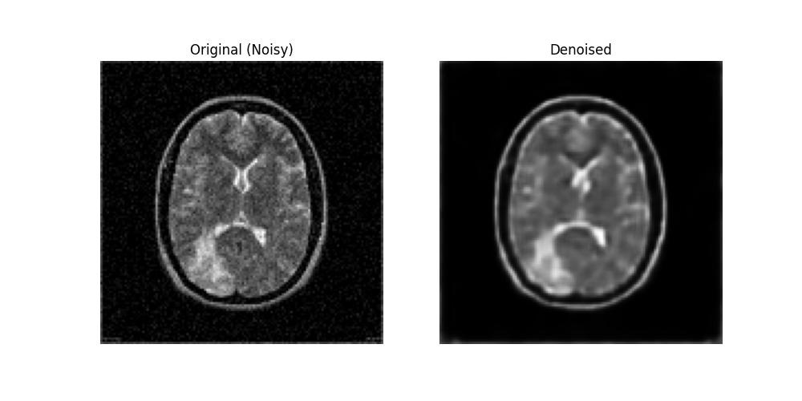
Visual Comparison: Noisy vs. Denoised MRI . The left image shows the original noisy MRI scan, while the right image displays the denoised output from the autoencoder . The model effectively reduces noise while preserving key anatomical structures, demonstrating its practical utility in medical image enhancement.

Slide 28
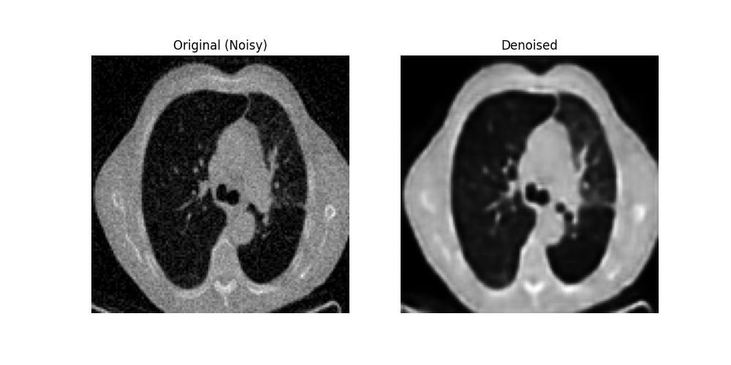
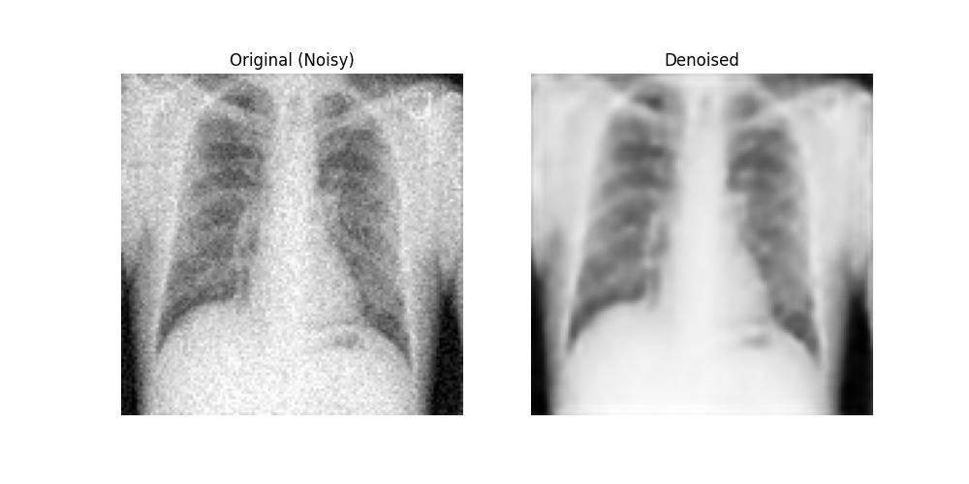

Slide 29
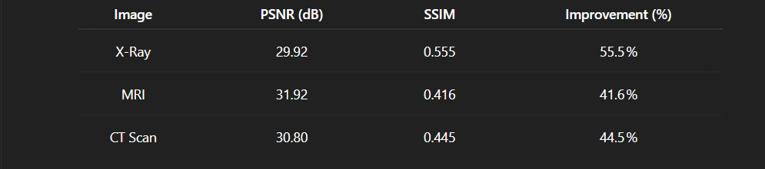
Do our model is performing better then other ways for denoising?

Slide 30

Smart Image denoising interface with file upload: Input

Slide 31
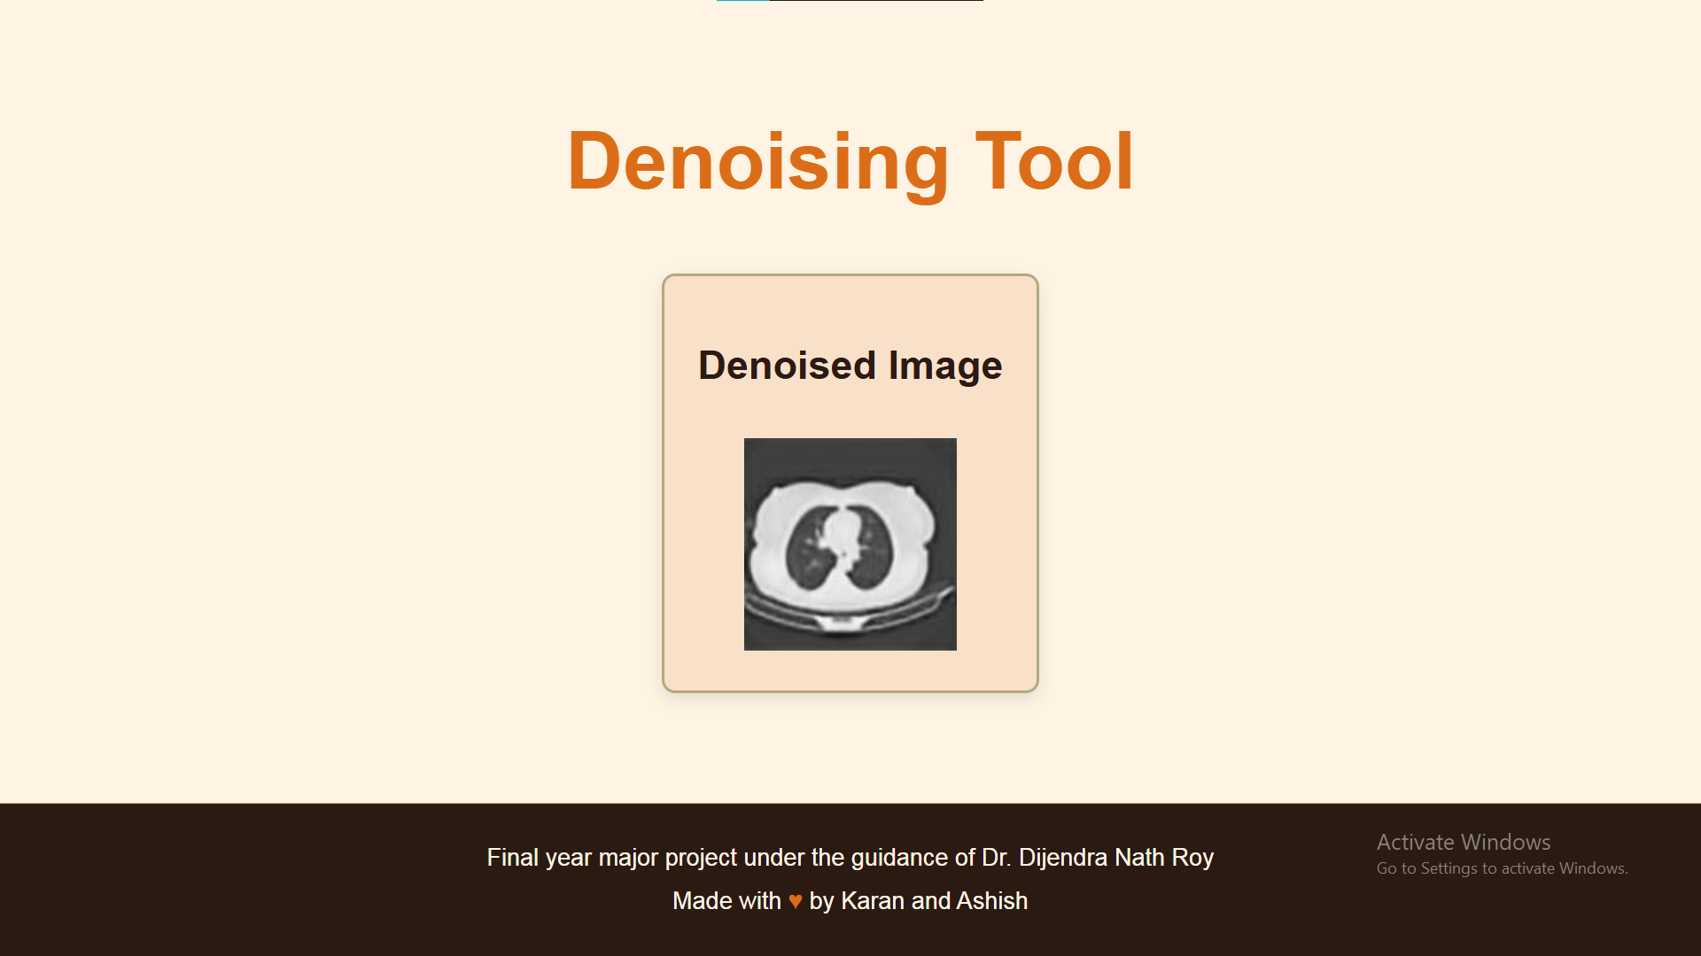
Output

Slide 32
Thank you

